Slide 1
Quantum HPC
Framework for Benchmarking & Scalability
DREU - Summer 2026 Research Project
Presented by
Kyle Hartness
DREU
Summer
2026

Slide 2
Presentation Overview
1
Flow Diagrams
2
Project Folder Layout
3
ZZFeatureMap Circuit
4
Library Comparisons
5
AerSimulator
6
Future Work / My Path
DREU
Summer
2026

Slide 3
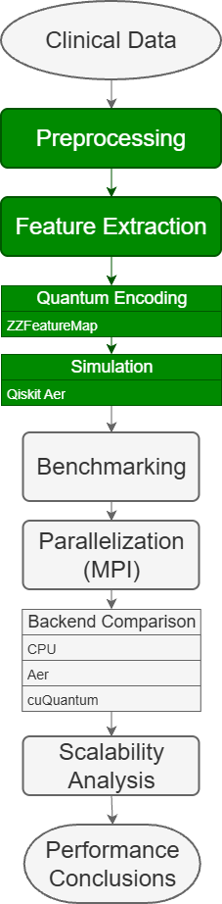
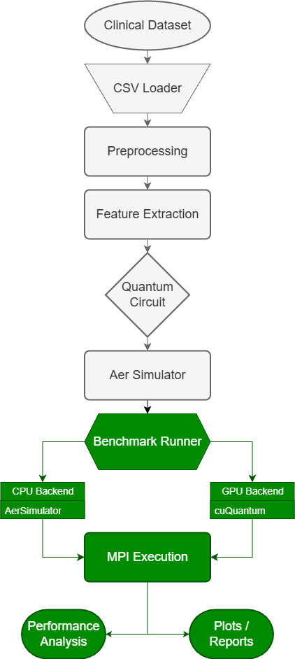
Flow Diagrams
Weeks 1-2
Week 3+
Quantum Circuits
HPC, MPI, Benchmarking

Slide 4
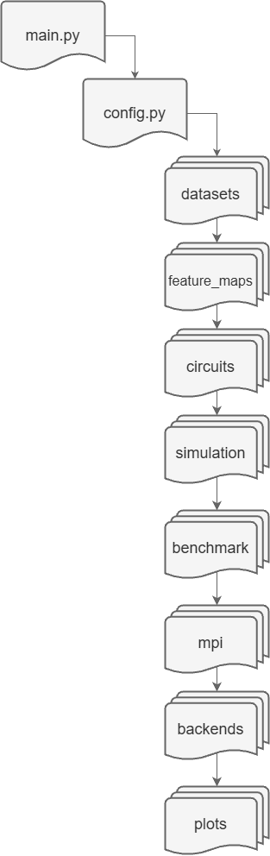
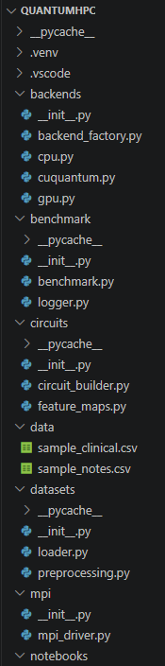
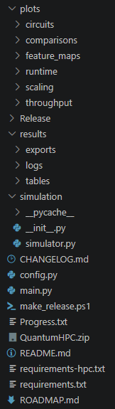
Project Folder
main.py = primary executor/entry-point
config.py = configurable settings
datasets/ = load/preprocess dataset(s)
feature_maps/ = build parameterized quantum feature maps
circuits/ = construct circuits
simulation/ = run circuits with Qiskit Aer
benchmark/ = measure execution time and performance
mpi/ = future distributed execution with MPI
backends/ = CPU and future GPU/cuQuantum support
plots/ = save generated figures

Slide 5
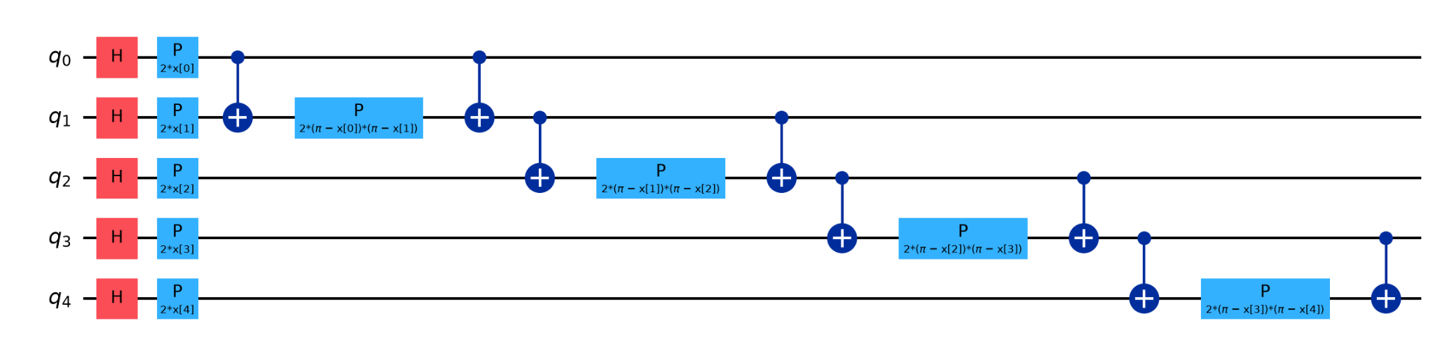
ZZFeatureMap Circuit
Features / Qubits (q) - each numerical feature is mapped to one qubit
Hadamard Gate (H) - places qubits in superposition
Phase Gate (P) - encodes classical feature values into quantum phases
CZ Gate (+) - entanglement; creates correlations between features

Slide 6
Library Comparisons
Qiskit
Qiskit Aer
pytket
lambeq
DisCoPy
DisCoCat
USED
USED
FUTURE?
IBM
IBM
Quantinuum
Circuit construction, simulation, and flexible quantum algorithm development
Primary framework for building quantum circuits
Fast, high-performance simulator
Executes and benchmarks circuits without physical hardware
Circuit optimization and backend compilation
Could be used to optimize circuits before execution on HPC systems
More advanced but more capabilities than Qiskit
RELATED
RELATED
RELATED
Quantinuum
Open-source (Oxford)
Oxford University
Quantum NLP
Targets language models instead of numerical feature mapping
Useful when working with strings rather than numbers
Diagrammatic quantum circuit framework
Useful for representing quantum circuits graphically
Python compatibility
Categorical framework for compositional linguistics
Foundation for many QNLP approaches, such as lambeq
DREU
Summer
2026

Slide 7
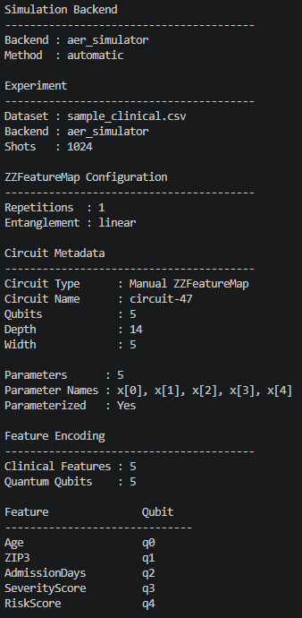
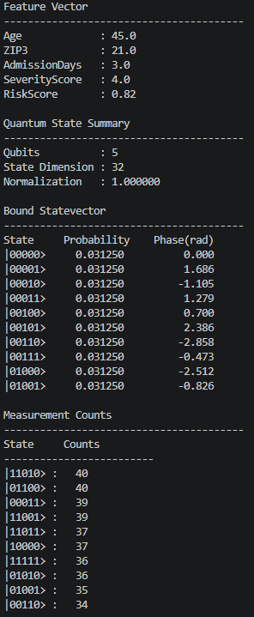
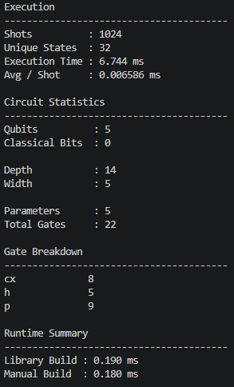
AerSimulator
Simulates quantum circuit execution
Displays statevectors and various measurement results
Collects and displays circuit statistics and runtime information
Reproducible and expandable environment for testing and benchmarking
DREU
Summer
2026

Slide 8
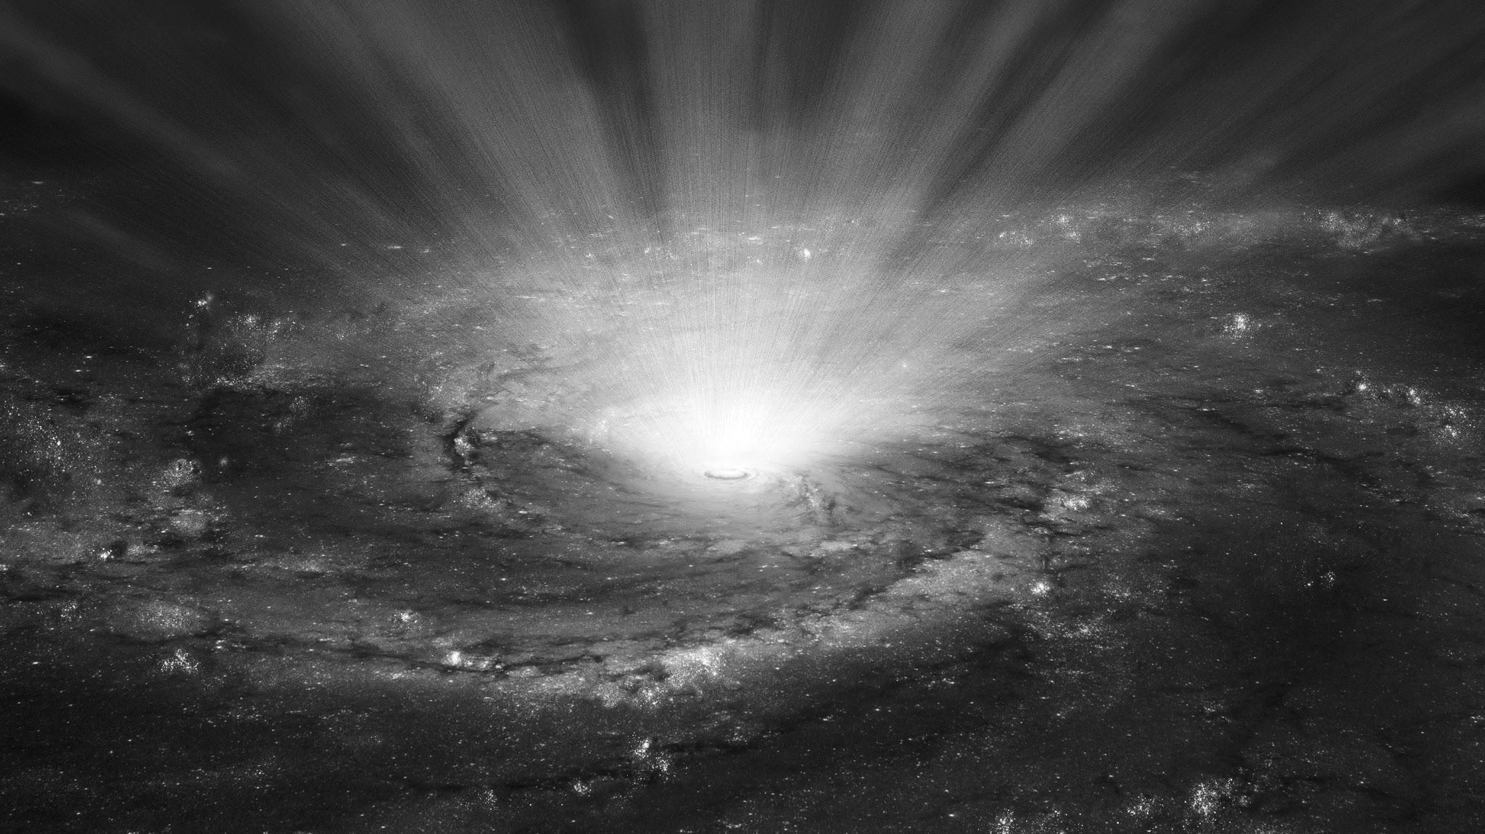
Future Work / Roadmap
1
2
3
4
5
Benchmarking Framework
Noise & Backend Evaluation
MPI Parallelization
Scalability Analysis
Research Integration
Extend the simulator to collect execution time, circuit statistics, and performance metrics for reproducible experiments. Initialize Github archive.
Evaluate circuits under different Aer noise models and compare CPU execution with GPU/cuQuantum backends.
Distribute quantum kernel simulations across multiple processors/cores to improve scalability for larger datasets.
Measure strong and weak scaling, compare hardware performance, and analyze computational bottlenecks.
Finalize performance results, contribute figures and analysis to the final report/paper, and finalize the GitHub research archive.
Weeks 2-3
Weeks 3-5
Weeks 5-7
Weeks 7-9
Weeks 9-10
CDREU
Summer
2026

Slide 9
Thank you
Sources:
https://www.ibm.com/quantum/qiskit
https://qiskit.github.io/qiskit-aer/#
https://docs.quantinuum.com/tket/api-docs/
https://docs.quantinuum.com/lambeq/guide/
https://docs.discopy.org/en/main/
https://arxiv.org/pdf/1003.4394
Questions?
DREU
Summer
2026

